Slide 1

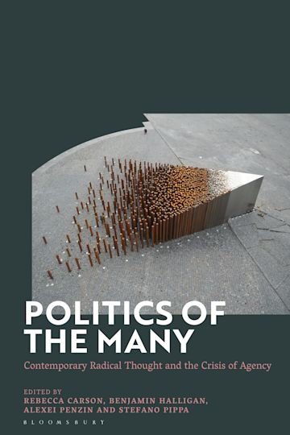
Multitude Void:
The Regal Mode of Imperial
Legitimation
Benjamin Halligan

Slide 2
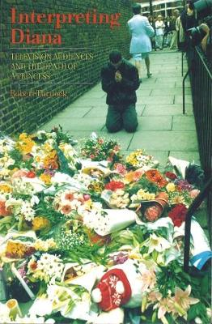
Rob Turnock, Interpreting Diana: Television Audiences and the Death of a Princess
(London:
British Film Institute, 2000)

Slide 3
“Television as comforter”
“Not only did television institutionally sanction Diana’s death as something important, but also the appearance of members from different levels of the establishment and the depiction of a broad sweep of the public (with particular emphasis on young people, gays and blacks) offered some reassurance to those upset at home that their emotions were not aberrant ... many rushed to their televisions for confirmation of the news of Diana’s death ... for reassurance that others were feeling and responding in the same way.”

Slide 4
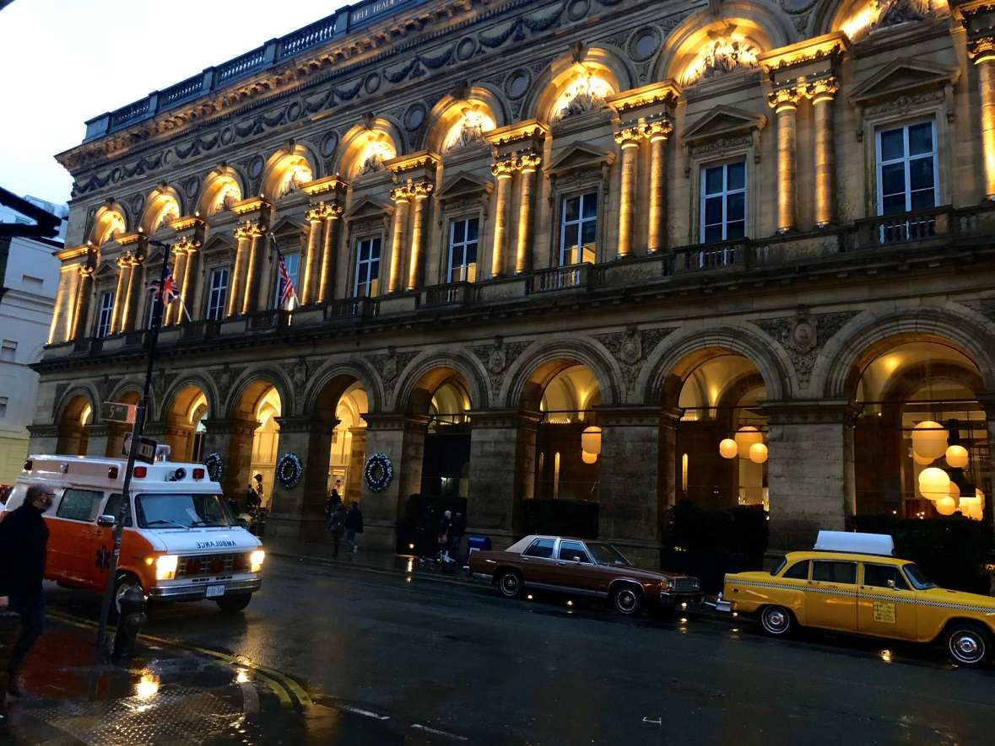
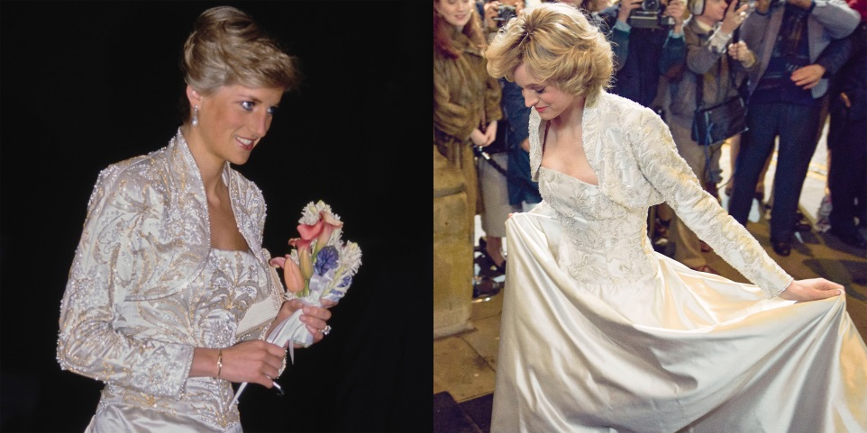
The filming of the Netflix series The Crown in February 2020, with Manchester doubling as the New York of 1989

Slide 5
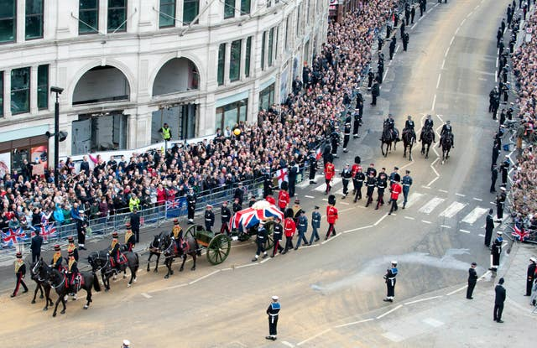
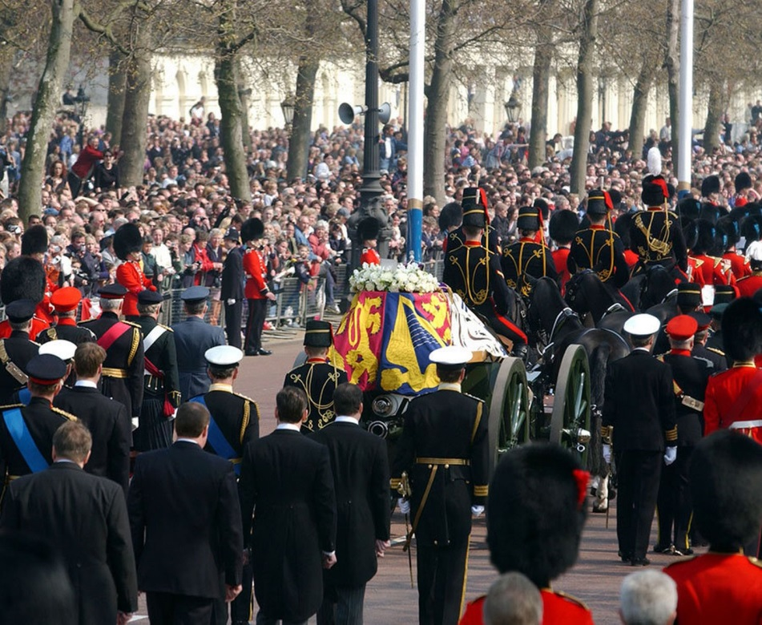
Alan Bennett on extras: “seldom given much encouragement by directors and often treated as not much more than moveable scenery”

Slide 6


Slide 7
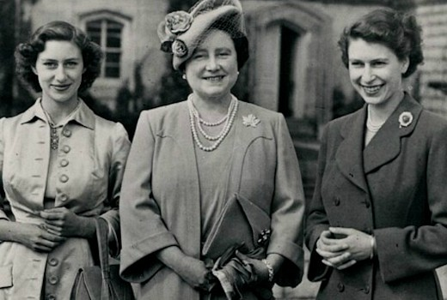
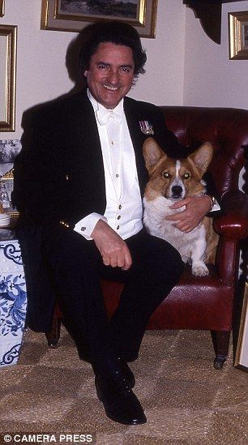
A lesser star in the Royal firmament: the Queen Mother, whose funeral was held on 9 April 2002
(i.e. between crises of 1997 and 2020; with “Backstairs Billy” as the only related scandal).
This analysis draws on just a few eventless minutes of
BBC One’s television coverage, which lasted several hours across that afternoon.
2002 represents a pre-social media age, and therefore this operation of making meaning is bolder, since it is understood to be more absolute and less fragmented: this coverage as the media concerning this event.
And the Queen Mother represented a figure less charged or freighted in terms of the idea of, as it were, a concept of history: this was not a beginning (as with a coronation or marriage), and not the passing of someone whose currency with the times was anything like that of Diana.

Slide 8
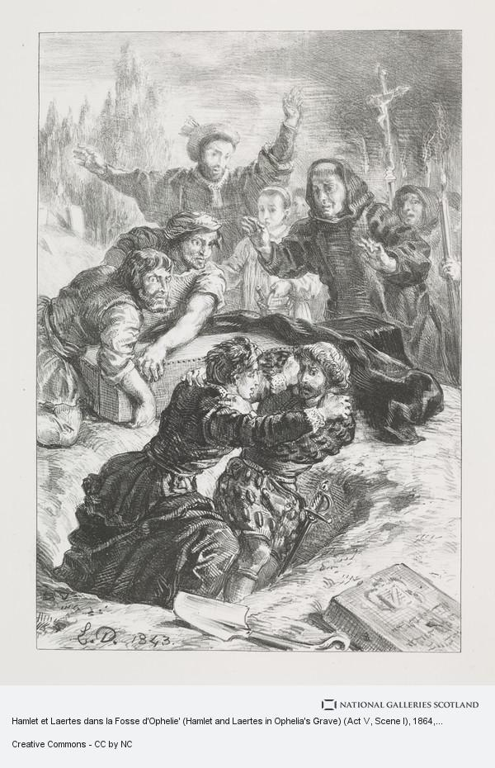
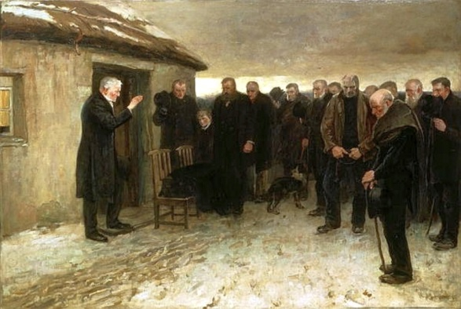
Hamlet et Laertes dans la Fosse d'Ophelie (Eugene Delacroix, 1864)
A Funeral Service in the Highlands (James Gutherie, c. 1882)

Slide 9
Framing 1: ‘The dimensions of the democratic and ethical aberration that are the British Royal Family are such that a popular mandate seems to be understood to be a necessity for its continued survival. No such mandate exists or has been invited; it has only ever been surmised, as a constant from the notion of divine selection, to the secular age – that is, across, as Faus puts it, “the slow historical birth of a desacralization of authority and the emergence of what we usually call democracy.”’
Faus, José Ignacio González, “Anthropology: The Person and the Community.” In Mysterium Liberationis: Fundamental Concepts of Liberation Theology, edited by Ignacio Ellacuría and Jon Sobrino, 497-521. New York: Orbis Books, 1993.

Slide 10
Framing 2: “... communicative production and the construction of imperial legitimation march hand in hand and can no longer be separated. The machine is self-validating, autopoietic – that is, systemic. It constructs social fabrics that evacuate or render ineffective any contradiction...”
Michael Hardt and Antonio Negri, Empire (London: Harvard University Press, 2001), 34.

Slide 11
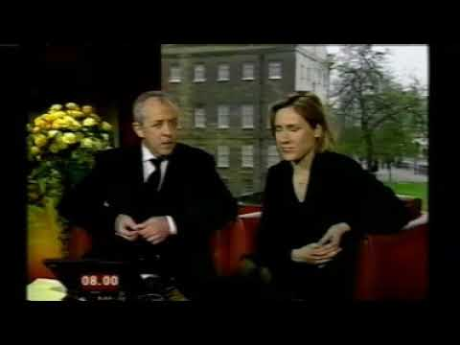
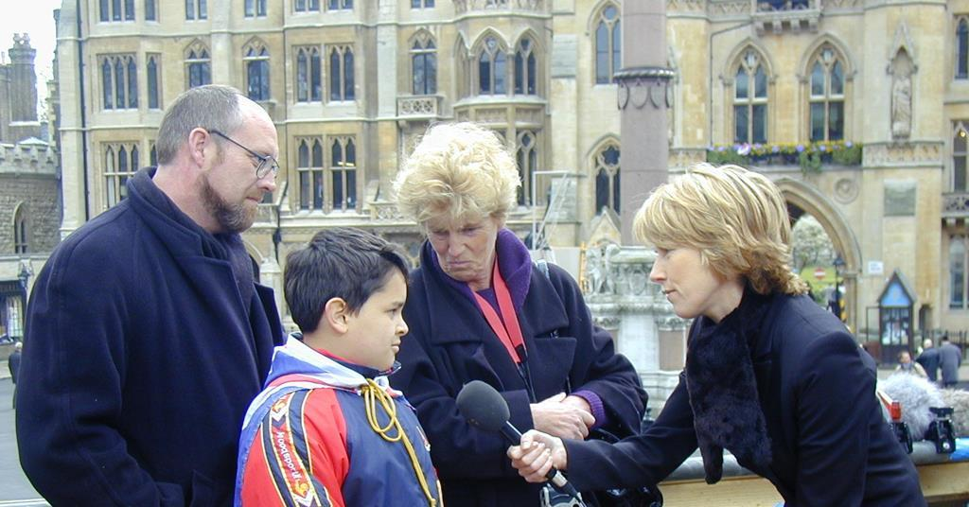
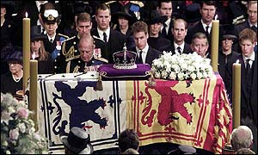
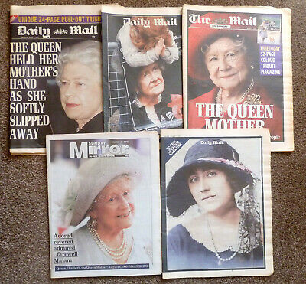
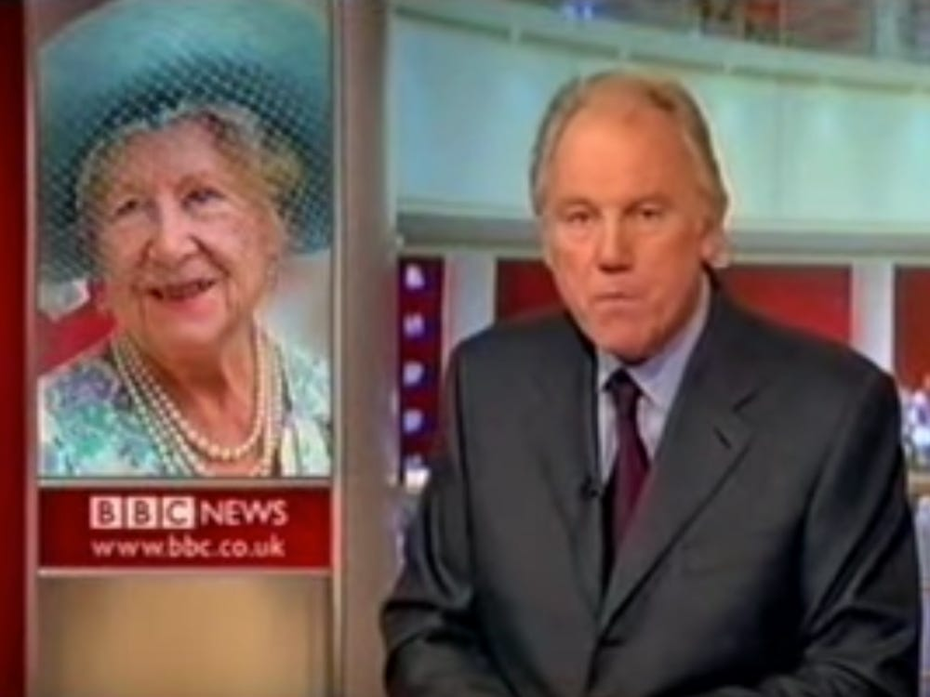
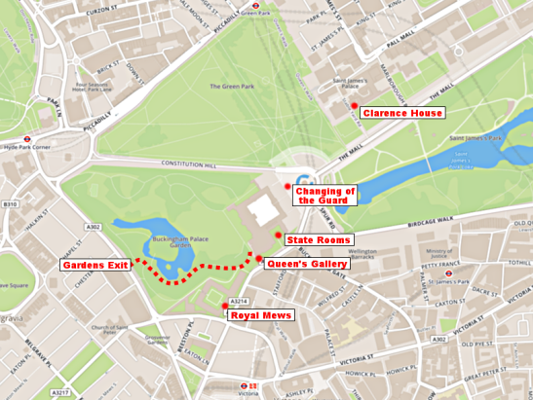
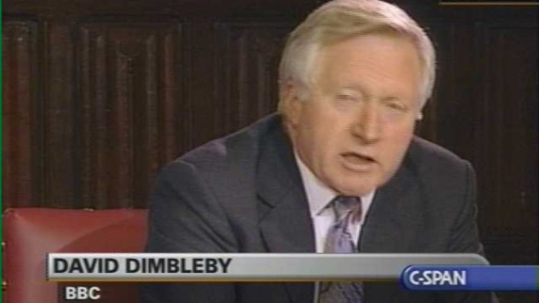
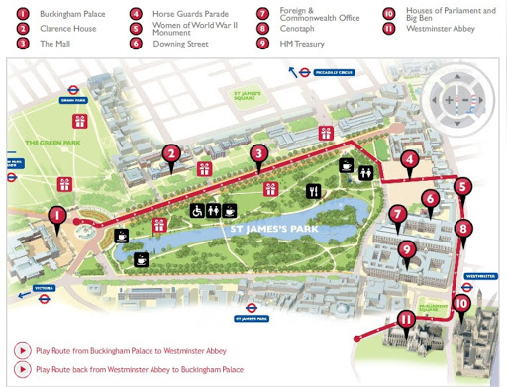
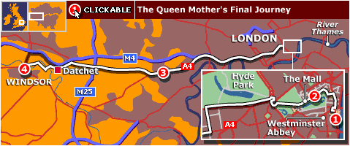
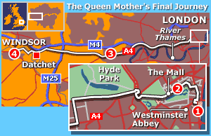

Slide 12
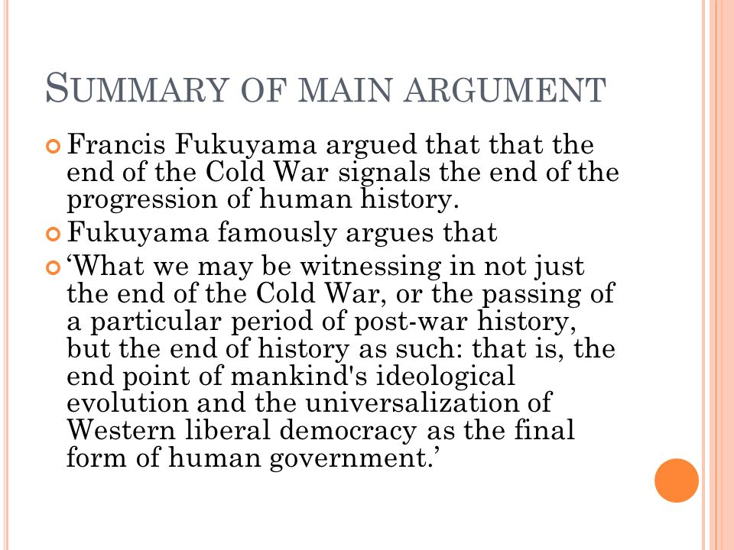
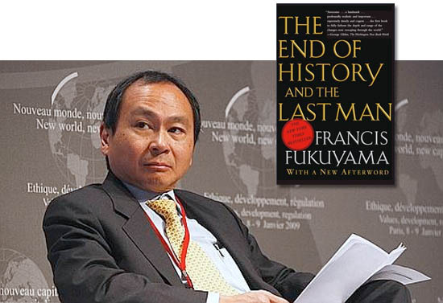
Conclusion framing 3:

